Slide 1
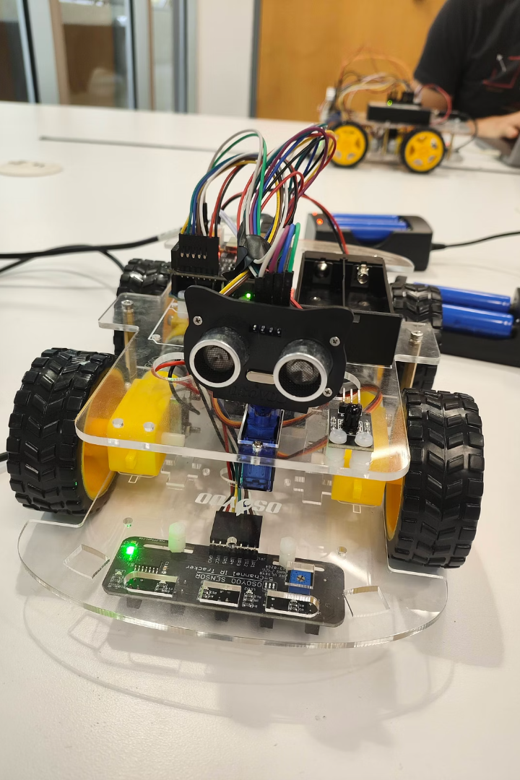
Autonomous Robot
(Line-Following and Obstacle-Avoidance)
Explore building an autonomous robot that follows lines and avoids obstacles.
Members : Ricardo Jose Molina Gonzalez , Reza Naidji and Samuel Williams
Class : ETS1603C Intro to Robotics
Professor : Virgilio Acuna

Slide 2
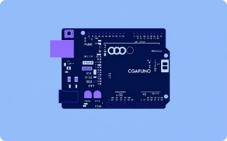
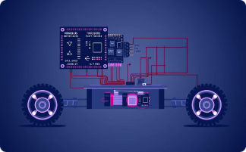
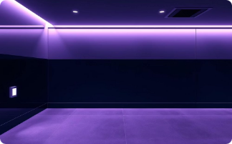
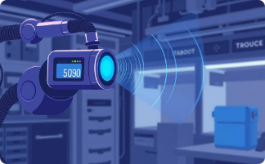

Hardware Design and Components
Arduino Uno
Motor Driver & Wheels
IR Sensors
Ultrasonic Sensors
Acts as the central controller for all robot components.
Controls the four wheels to enable robot movement.
Detect the black tape lines on the surface.
Measure the distance to obstacles for collision avoidance.
Scanning Direction
Servo motor adjusts sensor direction to ensure precise detection.

Slide 3

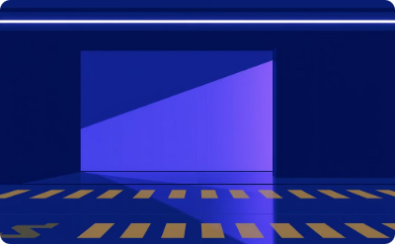
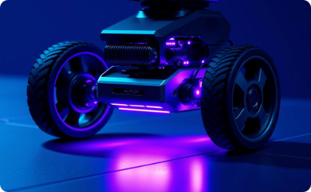
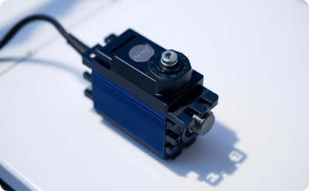
Hardware Limitations Affecting Robot Performance
Sensor Precision: IR sensors can misinterpret surface textures, which decreases the accuracy of line detection.
Ultrasonic Range: The limited detection distance restricts reaction time to obstacles. Additionally, the sensor's position on the robot may fail to detect objects at certain heights.
Motor Response: Basic motor drivers introduce delays in turning and speed adjustments, impacting responsiveness.
Servo Range: Limited scanning angles reduce the coverage area for obstacle detection.

Slide 4
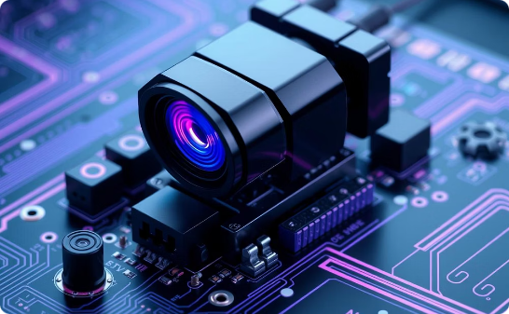
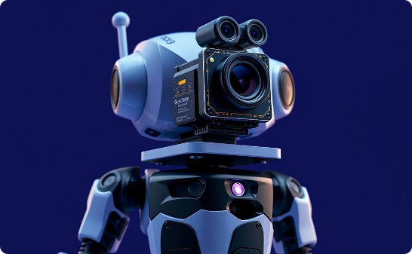
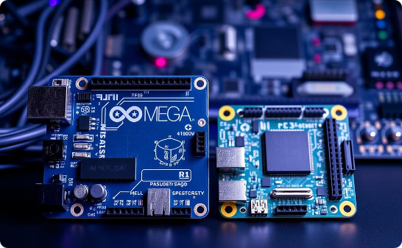
Upgraded Hardware for Improved Performance
Enhanced Sensors
Additional Hardware
Processor Upgrade
High-precision IR sensors improve line detection. LIDAR replaces ultrasonic for precise obstacle sensing.
Gyroscope for orientation and balance
Arduino Mega offers more pins and memory; Raspberry Pi adds processing power and Linux support.
Camera for object detection

Slide 5
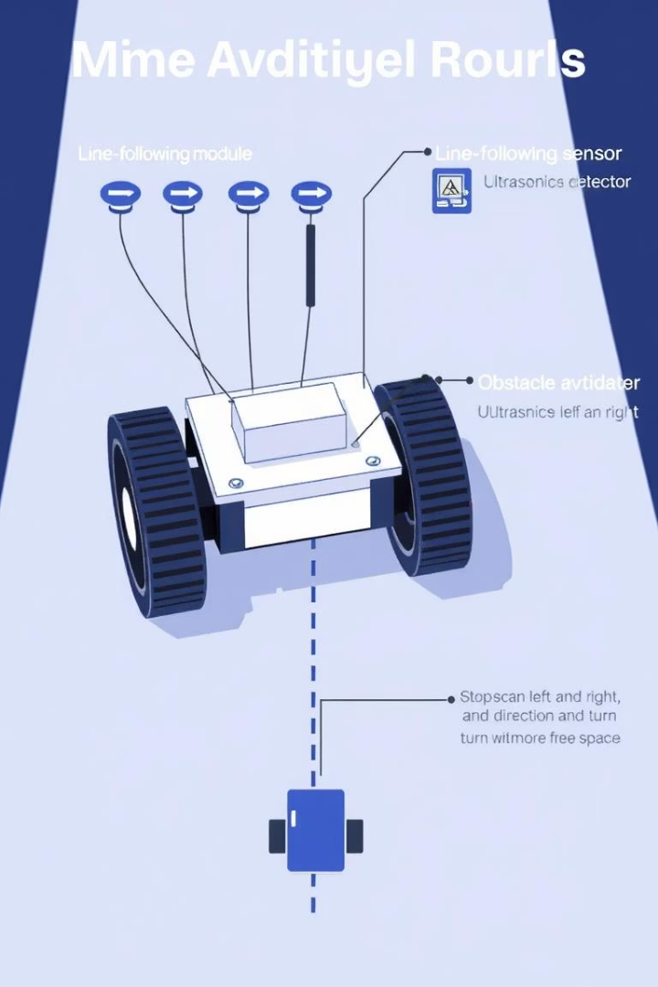



Algorithms and Code Logic: How the Robot Makes Decisions
Line Tracking
Obstacle Avoidance
Continuously detect and follow the black line to keep the robot on track.
Identify obstacles and decide the best alternative path to avoid collisions.
Code Quality
Organized into distinct functions with clear comments for maintainability.

Slide 6

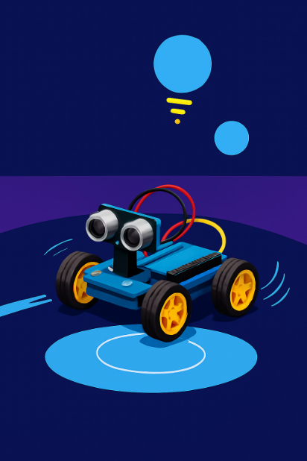



Line Tracking Logic Explained
Sensor Reading
Continuously read values from left, right, and center IR sensors.
Directional Movement
Left sensor detects black: Turn left
Right sensor detects black: Turn right
Center sensor detects black: Move forward
Stop Conditions
All sensors detect black: Robot stops, possible end of track
All sensors detect white: Initiate 2-second search timer
Line Lost Timer
Starts when no black line is detected. Robot moves forward attempting to find line.
Stops if line is found; resets timer. If not found in 2 seconds, robot halts.

Slide 7
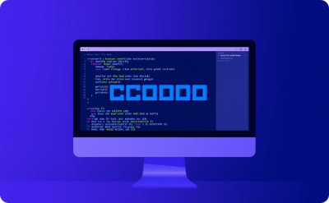

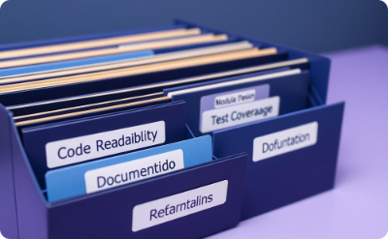
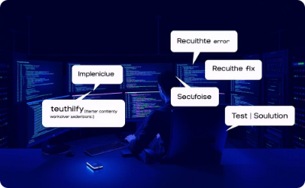
Code Quality and Structure
Modular Functions
Readable Comments
Maintainability
Error Handling
Reusable, clear functions for easy debugging and code reuse.
Descriptive explanations clarify code behavior and logic decisions.
Well-structured code that supports quick updates and feature additions.
Functions isolate issues, simplifying problem diagnosis.

Slide 8





Obstacle Avoidance Logic Explained
Detect Obstacle
If distance < 15 cm, stop immediately and wait 2 seconds.
Scan Directions
Rotate servo left and right to measure distances on both sides.
Choose Path
Turn towards side with more free space for 600 ms; stay stopped if none.
Resume Movement
Move forward and search for black line for 3 seconds; stop if lost.

Slide 9
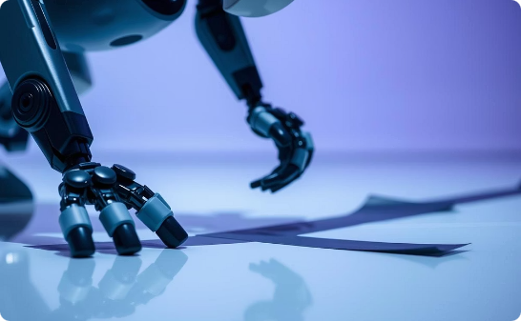
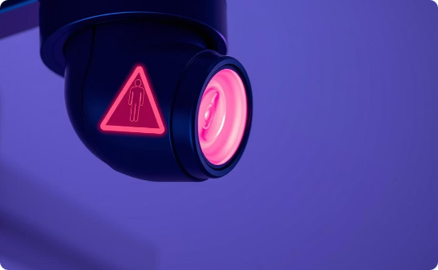
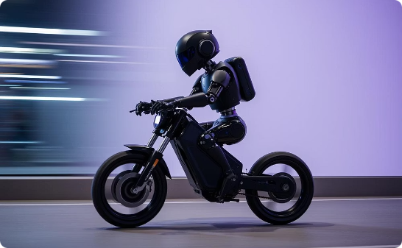
Testing Behavior and Sensor Challenges
Unexpected Behavior
Sensor Issues
Impact on Testing
Robot often responds better to white surfaces than detecting black tape.
Malfunctioning IR sensors cause inaccuracies in line tracking.
Sensor faults lead to erratic robot movement requiring careful troubleshooting.

Slide 10
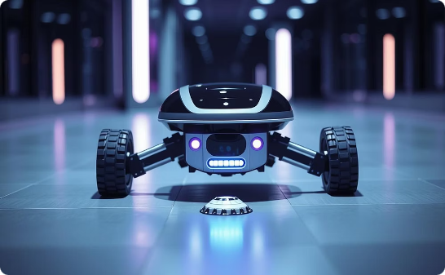

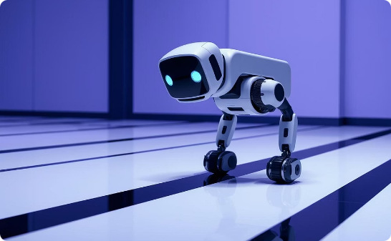
Sensor Limitations in Obstacle Detection
Obstacle Detection Height
Stop and Reroute
Line Rejoining Error
Sensors often miss low-lying obstacles, reducing safety coverage.
The robot stops for 2 seconds before scanning for alternative paths. It effectively reroutes but is unable to recover the line afterwards.
White spaces are sometimes mistaken for black tape, causing failure to realign correctly and leading the robot to move erratically throughout the environment.
These sensor limitations disrupt smooth tracking and reduce navigation accuracy.

Slide 11
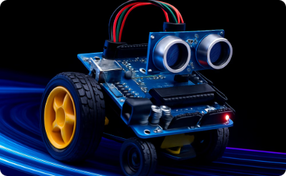
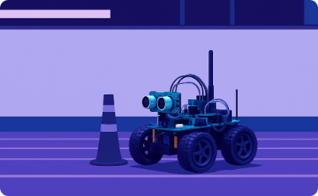
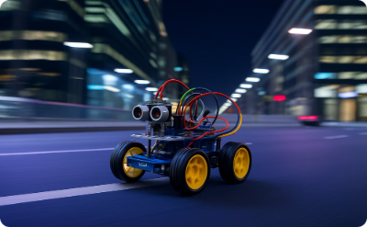
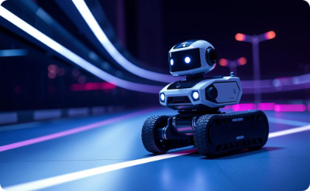
Robot Speed Control and Maneuvering
Adaptive Speed
Reverse Capability
Consistent Performance
Enhanced Navigation
Adjusts speed smoothly on curves for better control
Moves backward to correct position or avoid obstacles
Precise speed control improves tracking and obstacle avoidance
Maintains steady speed without losing stability

Slide 12
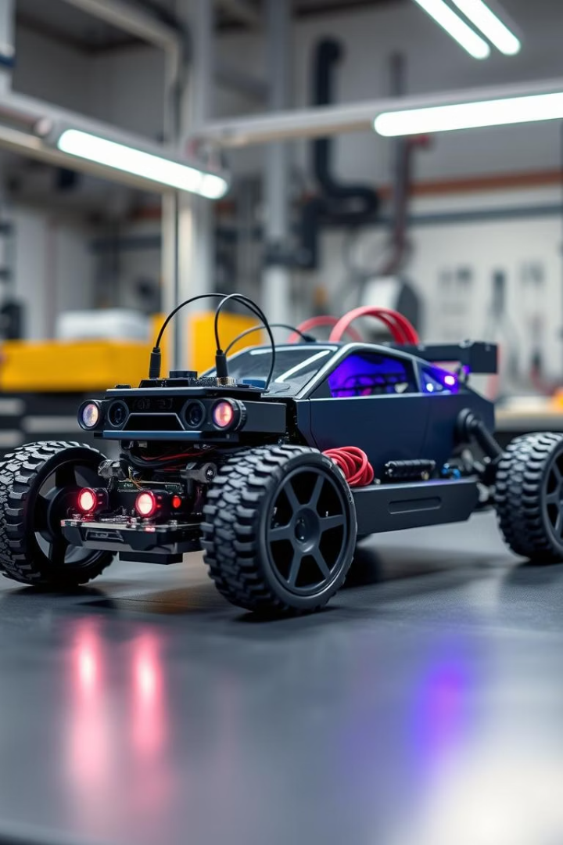
Challenges and Solutions
Detection Issues
Line Loss
Sensor Coverage
Calibration
Fine-tuning motor control improved navigation around sharp bends.
Motor speeds were calibrated to balance sensor sensitivity with smooth driving performance.
Implementing servo scanning resolved the unreliability in detecting nearby obstacles.
Lacking rear sensors, efforts concentrated on enhancing forward scanning capabilities.

Slide 13
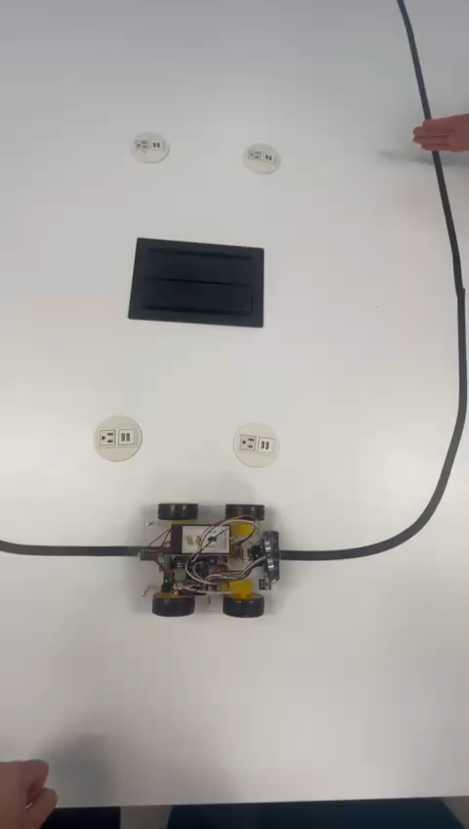
Demo Presentation

Slide 14





Results and Future Improvements
Current Achievements
The robot reliably follows the tape and navigates curves and intersections with precision.
Rear Obstacle Detection
Add sensors to provide full 360-degree obstacle awareness.
Enhanced Control System
Implement a PID controller for smoother and more precise line following.
Software Improvements
Develop advanced decision-making capabilities to better handle environmental challenges.

